Slide 1
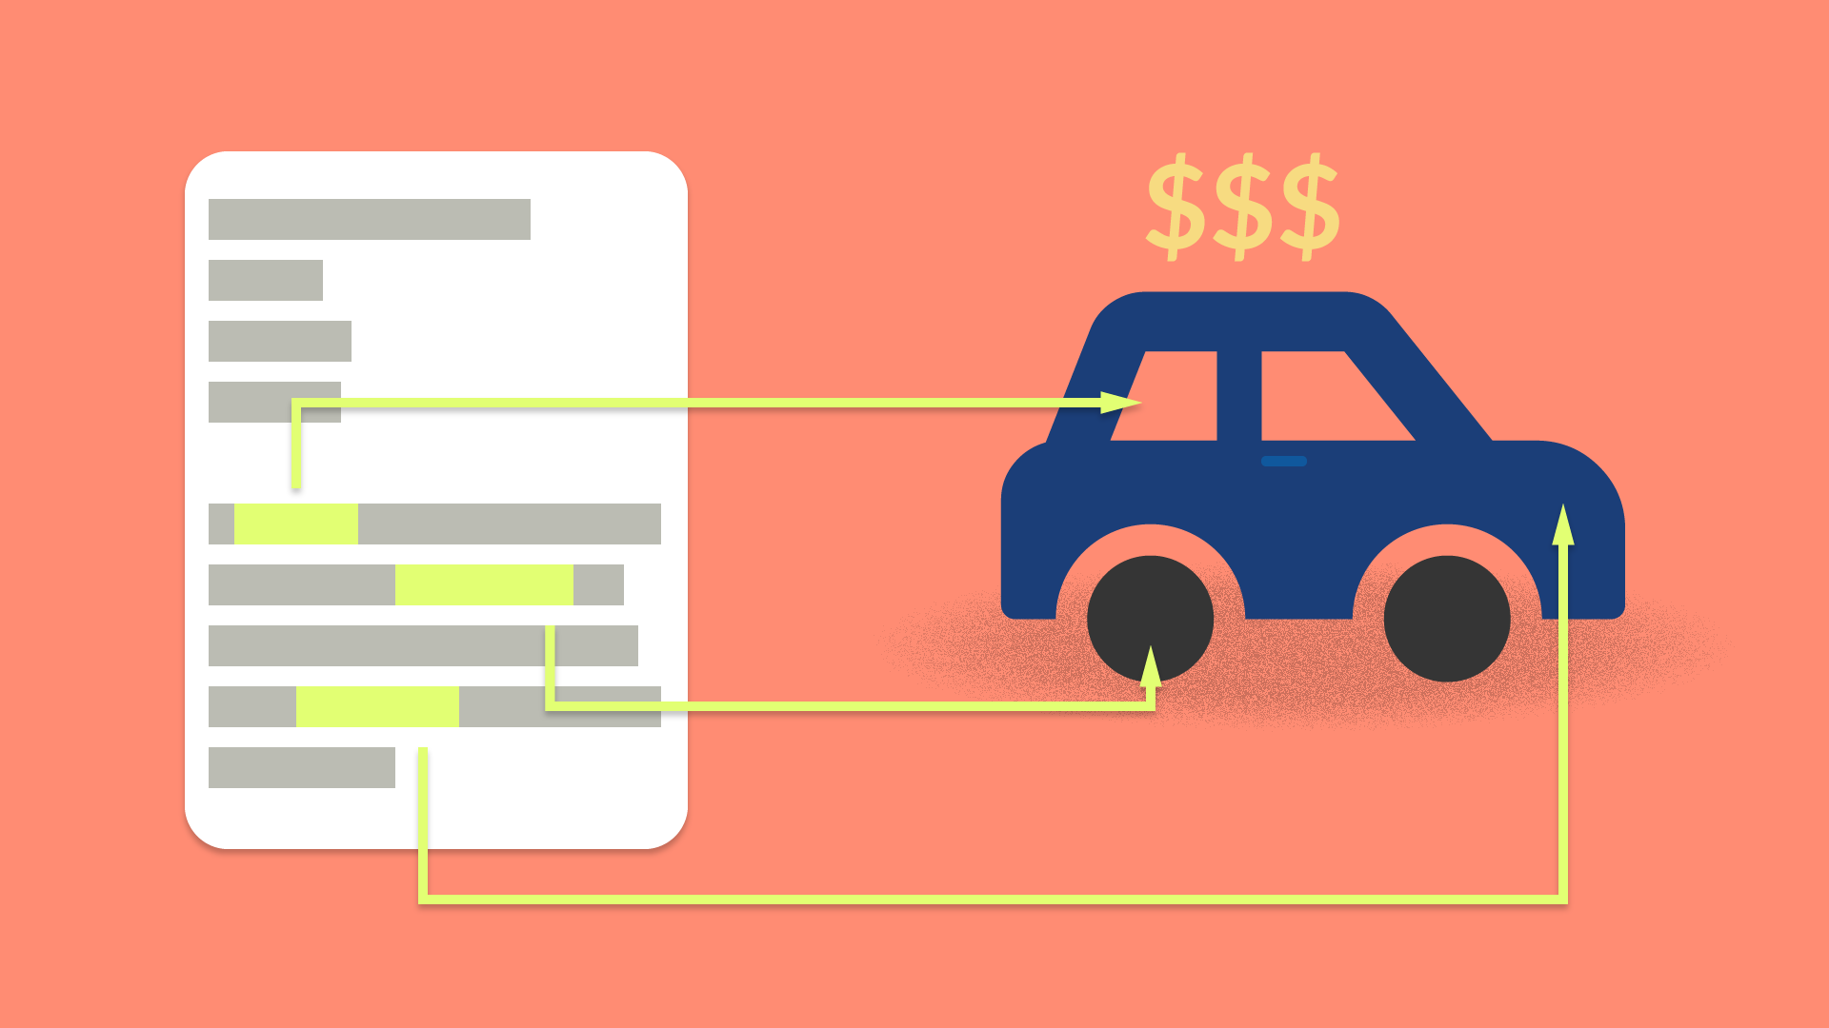
Car Price Prediction
Konatala Mohit
Intership-23 , ID-34

Slide 2

Abstract
Introduction
Descriptive Analysis
Data Visualization
Data cleaning and modifying
Feature Selection and Model Training
Conclusion

Slide 3

Abstract
Data analysis and model building on collected data from Cardekho website to predict the sale price of the used cars from various city.

Slide 4

In this presentation I will be discussing about car price prediction using few of the machine learning models via python and its libraries. Transportation is one greatest invention of man-kind which truly helped connecting the world resources around the world. The invention of a true four-wheel automobile was done by Carl Benz on January 29th 1886. Over the period of 125 year many modifications and improvement have been made to an automobile so that any common person could use an automobile. Automobiles come under the category of perishable goods i.e., the goods that depreciate as they age and automobiles have a high depreciation rate of all the perishable goods due to which a newly purchased automobile for few people becomes a liability. To counter-act the liability issues most people prefer used car.

Slide 5

Exploratory Data Analysis
Objective:
Analysis of the data set and summarizing the factor that effect the sale price of the used cars.
Understanding the Data Via Descriptive analysis
Size of the data is small contains only 10047 and 10 rows in train and test respectively
Price is the target column

Slide 6
Data contains Null Values in gear type column
Data contains both numerical and categorical data
Descriptive analysis is used as it gives the basic value Insite of the data in our dataset.
It helps in organize the data and summarize the data while describing the characteristic of data.

Slide 7
Data Visualization
Data visualization is one simplest way to get a proper idea about the characteristics of the data just from vision. In much simpler words , we Visualize the descriptive stats of the data in pictorial format. Also the data characteristic are represented in eye soothing way
Identifying pattern, understanding is the data is more easier through visuals.

Slide 8
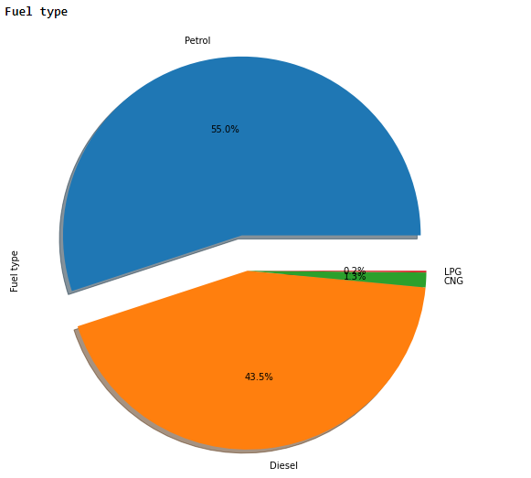
Independent variables influencing the target variable pie chart

Slide 9
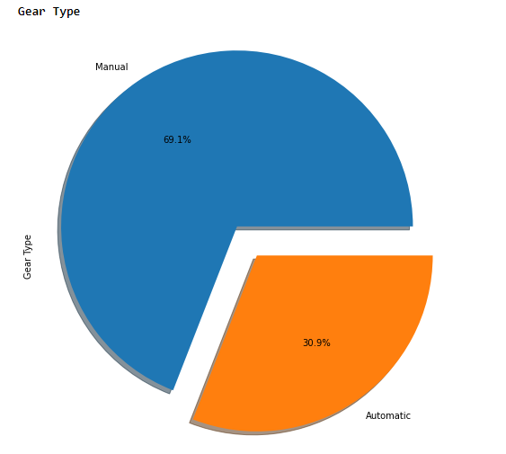
Independent variables influencing the target variable pie chart

Slide 10
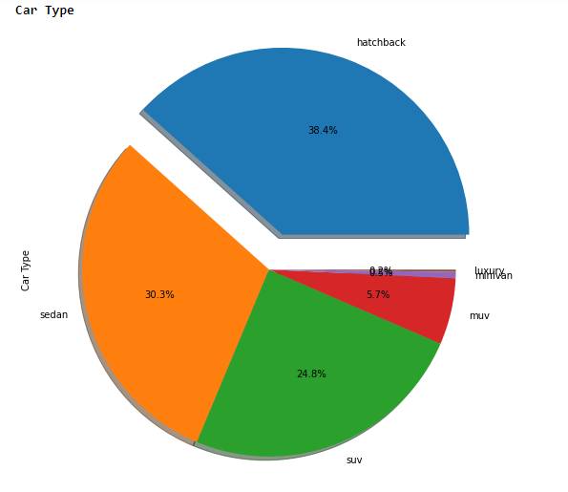
Independent variables influencing the target variable pie chart

Slide 11
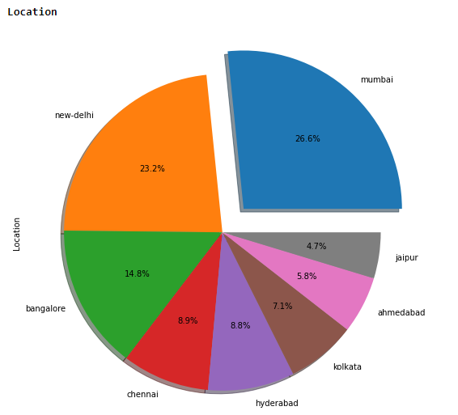
Independent variables influencing the target variable pie chart

Slide 12
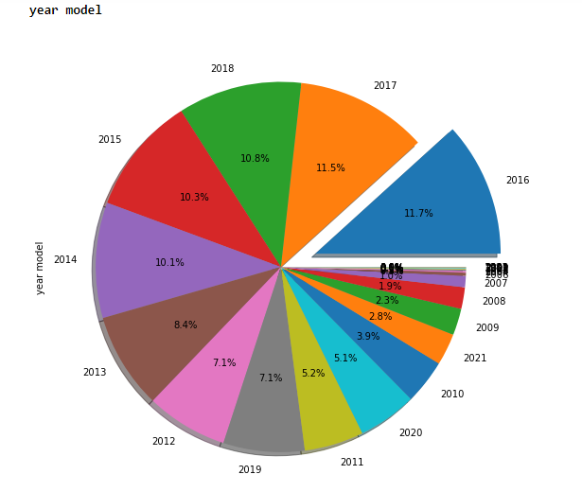
Independent variables influencing the target variable pie chart

Slide 13
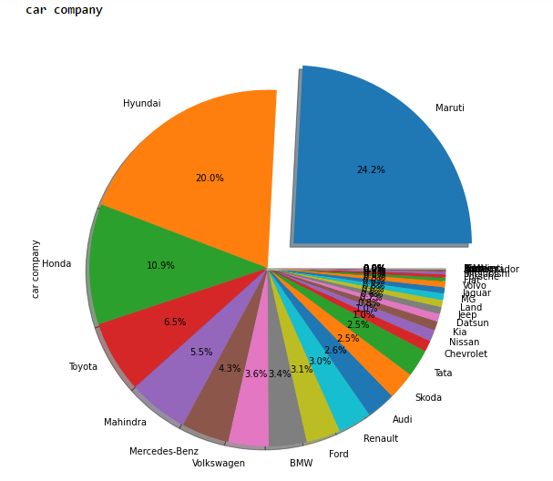
Independent variables influencing the target variable pie chart

Slide 14
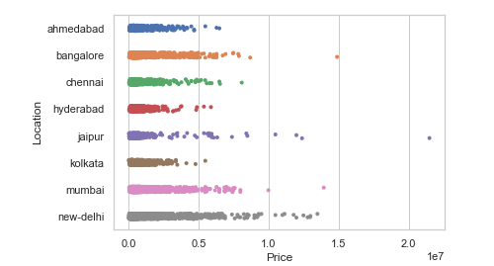
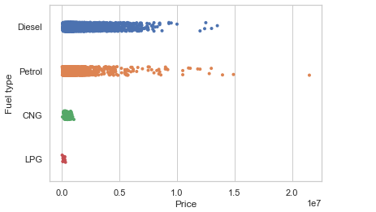
Bivariate Analysis

Slide 15
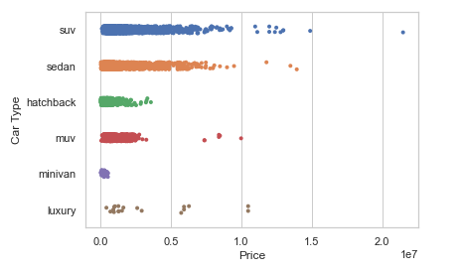
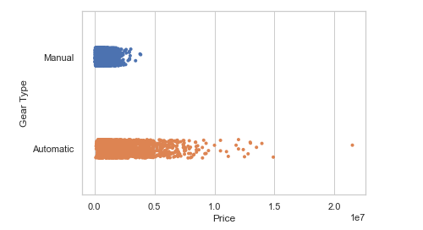
Bivariate Analysis

Slide 16
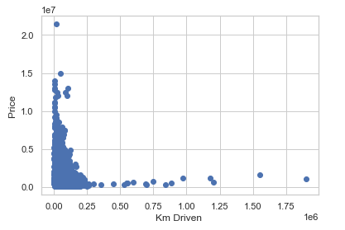
Bivariate Analysis

Slide 17
Cleaning the Data
Cleaning data is one of the most important procedure in data analysis i.e. detecting and modifying or removing the inaccurate data from the dataset so as improve data quality
Tasks in data cleaning:
Handling null values
Arresting outliers
Removing Skewness if required
Feature Selection

Slide 18
Arresting outliers observed in visualization:
Some of the columns have outliers or unique data which are overlapping with other element when looked bi- variate analysis, such are clubbed in one type. Example is shown below.
Feature Selection and Normalization:
Feature selection is done on the basis of corelation (also to remove multi-collinearity) with the target variable and to improve model training. Normalization to remove bias from the data while feeding it to ML.

Slide 19
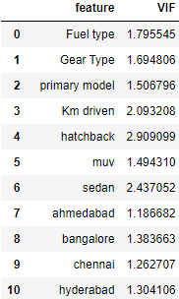
Variance Inflation Factor:
After Normalizing the data and feature selection VIF is used to cross check if there is any existence of multi-collinearity between the independent variable
Note :
VIF and Normalization should done only on independent variables i.e. after splitting the target data column.

Slide 20

Below the keys point in Summarizing the data analysis of Car Price Prediction data:
Size of the Dataset is 9871 rows and 52 columns.
No missing values in the dataset.
Converted categorical data into numerical data
outliers have been dealt with.
Feature selection of independent data is done via heatmap and VIF value.
Separate features and prediction variables into two separate list.

Slide 21
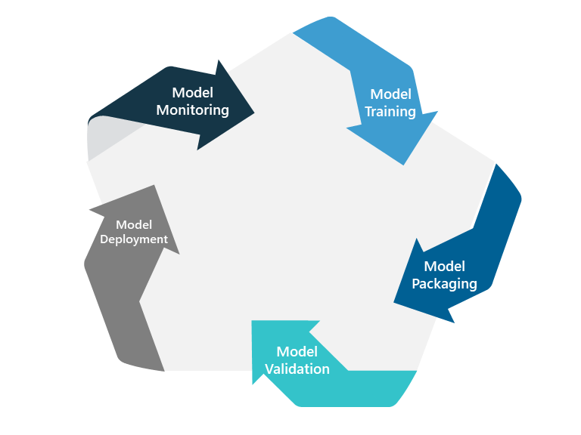
Model Training and Testing
Splitting the Data into Train and Test sets
Using hyperparameter tuning to get the best estimator for the model
Model Training
Cross Validation
Model Testing
Saving the model

Slide 22
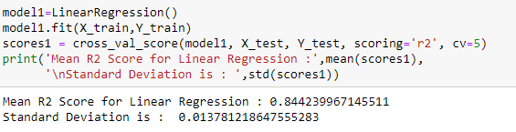

Slide 23
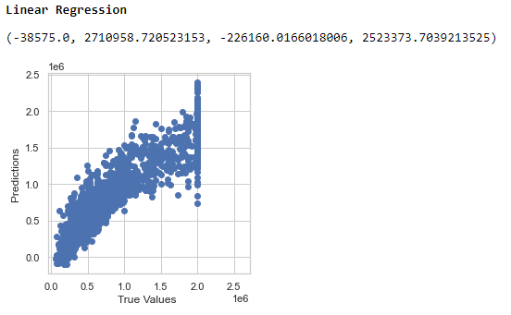

Slide 24

Limitations of this work and Scope for Future Work:
The type price predicted are only limited to particular city and the given models. When we try to predict price of different city and models the machine learning model will fail. Also, for used car most often the data for variety models is limited, as most of the data available are data of the best-selling cars therefore prediction of unique model is always constrained. To improve the model efficiency, we can introduce various other automobile factors such as engine power, mileage, interior quality, battery warranty, tyre quality and insurance of the vehicle etc., inclusion of these can improve the model quality.
Conclusion:
In the whole dataset Gear type column has the most influence on the price of the automobile. Car companies, km driven and model of the car are the other factors which have good influence on the price prediction.

